Slide 1
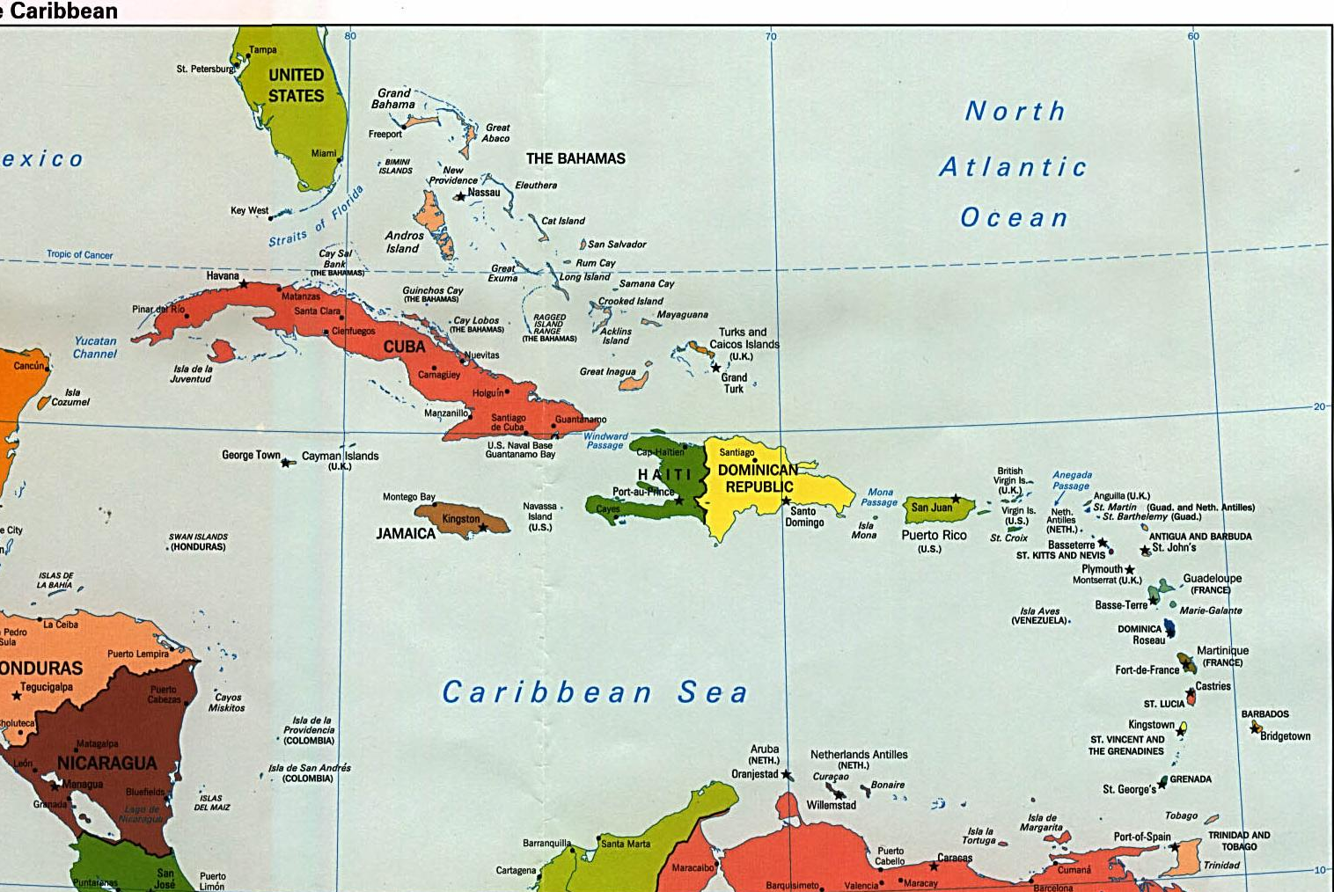
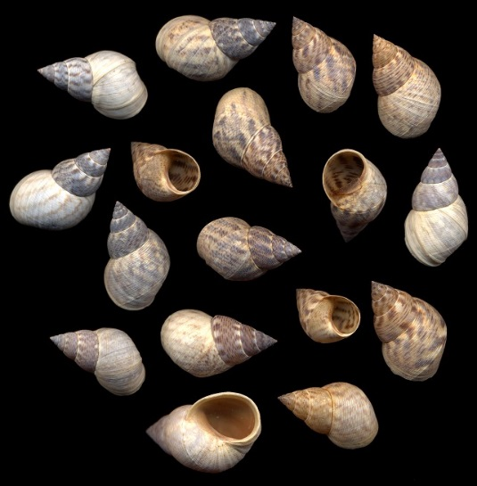
Cluster Analysis II
Hierarchical clustering

Slide 2
Polythetic Agglomerative Hierarchical Clustering (PAHC)
General Process
Calculate distance/dissimilarity matrix
Fusion method
Agglomerate samples to build up a hierarchy of increasingly
large clusters.
Choice of fusion method is up to investigator (there are metrics to compare)
All fusion methods cluster the two most similar samples first. Methods differ
in how they fuse subsequent samples (or clusters)

Slide 3
Polythetic Agglomerative Hierarchical Clustering (PAHC)
Calculate distance/dissimilarity matrix
Euclidean distance for continuous variables
Bray-Curtis and Mahalanobis distance also commonly
used for community data
Jaccard index for binary data
Gower’s dissimilarity index for mixed data

Slide 4
Polythetic Agglomerative Hierarchical Clustering (PAHC)
2) The general fusion process

Slide 5
Fusion Process
1
5
2
4
6
3

Slide 6
Polythetic Agglomerative Hierarchical Clustering (PAHC)
2) The general fusion process

Slide 7
Fusion Process
1
5
2
4
6
3

Slide 8
Polythetic Agglomerative Hierarchical Clustering (PAHC)

Slide 9
Fusion Process
1
5
2
4
6
3

Slide 10
Polythetic Agglomerative Hierarchical Clustering (PAHC)
3

Slide 11
Fusion Process
1
5
2
4
6
3

Slide 12
Polythetic Agglomerative Hierarchical Clustering (PAHC)
3

Slide 13
Fusion Process
1
5
2
4
6
3

Slide 14
Agglomeration Table
# of Clusters | Fusion | Minimum Distance
5 | Sites 1 and 2 | 1.4
4 | Sites 4 and 5 | 2.2
3 | Site 6 and Cluster 4-5 | 8.2
2 | Site 3 and Cluster 1-2 | 9.3
1 | Cluster 1-2-3 and Cluster 4-5-6 | 10.0

Slide 15
Dendrogram
A tree (dendro) diagram (gram) depicting the
agglomeration sequence where the samples are
identified on one axis and the dissimilarity at
which each fusion of clusters in on the other.
# of Clusters | Fusion | Minimum Distance
5 | Sites 1 and 2 | 1.4
4 | Sites 4 and 5 | 2.2
3 | Site 6 and Cluster 4-5 | 8.2
2 | Site 3 and Cluster 1-2 | 9.3
1 | Cluster 1-2-3 and Cluster 4-5-6 | 10.0

Slide 16
How to calculate distance between clusters?
1
5
2
4
?
?
6
3

Slide 17
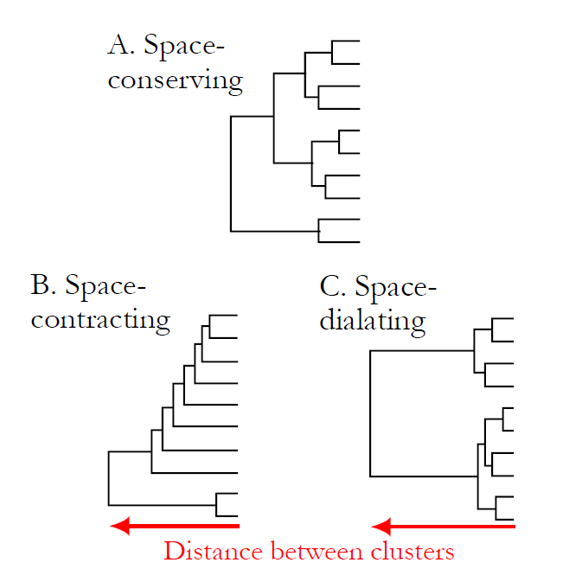
Fusion Properties
Space conserving fusion processes
preserve the properties of the
original distance matrix.
Space distorting fusion processes
distort the properties of the
original distance matrix.

Slide 18
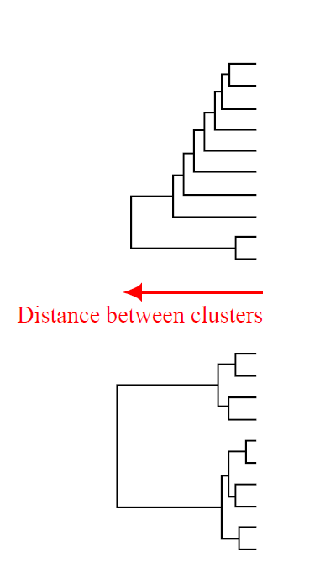
Fusion Properties
Space Contracting – groups appear to move
nearer to some or all of the remaining entities;
the chance that an individual entity will add
to a preexisting cluster rather than act as the
nucleus of a new group is increased, and
the system is said to “chain.”
Space-Dilating – groups appear to recede
on formation and growth; individual
entities not yet in groups are more likely to
form nuclei of new groups.

Slide 19
Fusion Strategies Single-Linkage (nearest neighbor)
A samples’ dissimilarity to a cluster is defined to be
equal to the closest sample in that cluster; for the
fusion of two clusters, dissimilarity is equal to the
smallest dissimilarity for any two pairs contingent on
one sample being located in each cluster.
Space-contracting method: produces “straggly” clusters
which can agglomerate very dissimilar samples.

Slide 20
Fusion Strategies Complete-Linkage (furthest neighbor)
A samples’ dissimilarity to a cluster is defined to be
equal to the furthest sample in that cluster; for the
fusion of two clusters, dissimilarity is equal to the
greatest dissimilarity for any two pairs contingent on
one sample being located in each cluster.
Space-dilating method: produces clusters of very
similar samples. As clusters agglomerate, groups
are moved away from each other.

Slide 21
Fusion Strategies Centroid-Linkage (Unweighted Pair-Group Centroid)
Cannot be used with Bray Curtis or Sorensen’s index.
A samples’ dissimilarity to a cluster is equal to it’s
dissimilarity to the cluster centroid; for the fusion
of two clusters, dissimilarity is equal to the
dissimilarity between cluster centroids.
Space-conserving method: can lead to reversals where
fusion takes place at a lower dissimilarity than a prior
fusion.

Slide 22
Fusion Strategies Centroid-Linkage (Unweighted Pair-Group Centroid)
X
Cannot be used with Bray Curtis or Sorensen’s index.
A samples’ dissimilarity to a cluster is equal to it’s
dissimilarity to the cluster centroid; for the fusion
of two clusters, dissimilarity is equal to the
dissimilarity between cluster centroids.
Space-conserving method: can lead to reversals where
fusion takes place at a lower dissimilarity than a prior
fusion.

Slide 23
Fusion Strategies Median-Linkage (Weighted Pair-Group Centroid)
Similar to centroid-linkage except that “centroids”
of a newly fused group are position at the median
between old group centroids
Space-conserving method: can still lead to reversals

Slide 24
Fusion Strategies Median-Linkage (Weighted Pair-Group Centroid)
X
Similar to centroid-linkage except that “centroids”
of a newly fused group are position at the median
between old group centroids
Space-conserving method: can still lead to reversals

Slide 25
Fusion Strategies Average-Linkage (UPGMA)
A samples’ dissimilarity to a cluster is defined to be
equal to the average of the distances between the
sample and each point in the cluster; for the
fusion of two clusters, dissimilarity is equal to the
average of the distances between each sample
in one cluster with each sample in the other cluster.
Space-conserving method: Maximizes correlation between
original distance matrix and the cluster dissimilarities.
Most robust and popular method.

Slide 26
Fusion Strategies Ward’s Minimum-Variance-Linkage
Agglomerates clusters, only if the increase in
within-group variance is less than it would be if either
cluster were joined to any other. Conceptually similar to
k-means.
Ward's method says that the distance between two
clusters, A and B, is how much the sum of squares will
increase when we merge them.
Space-conserving method: similar to average-linkage,
except instead of minimizing an average distance, it
minimizes a squared distance weighted by cluster size.
1
2
3

Slide 27
Fusion Strategies Ward’s Minimum-Variance-Linkage
Agglomerates clusters, only if the increase in
within-group variance is less than it would be if either
cluster were joined to any other. Conceptually similar to
k-means.
Ward's method says that the distance between two
clusters, A and B, is how much the sum of squares will
increase when we merge them.
Space-conserving method: similar to average-linkage,
except instead of minimizing an average distance, it
minimizes a squared distance weighted by cluster size.
1
2
3

Slide 28
Fusion Strategies Ward’s Minimum-Variance-Linkage
Agglomerates clusters, only if the increase in
within-group variance is less than it would be if either
cluster were joined to any other. Conceptually similar to
k-means.
Ward's method says that the distance between two
clusters, A and B, is how much the sum of squares will
increase when we merge them.
Space-conserving method: similar to average-linkage,
except instead of minimizing an average distance, it
minimizes a squared distance weighted by cluster size.
1
2
3

Slide 29
Fusion Strategies Ward’s Minimum-Variance-Linkage
Agglomerates clusters, only if the increase in
within-group variance is less than it would be if either
cluster were joined to any other. Conceptually similar to
k-means.
Ward's method says that the distance between two
clusters, A and B, is how much the sum of squares will
increase when we merge them.
Space-conserving method: similar to average-linkage,
except instead of minimizing an average distance, it
minimizes a squared distance weighted by cluster size.
1
2
3
*best used with Euclidean distance

Slide 30
Evaluating the Cluster Solution
Bootstrap samples
Randomization tests
Site | 3 | 2 | 1 | 7 | 2 | 6 | 7
A | 0.94 | 1.35 | 1.01 | 1.86 | 1.35 | -0.94 | 1.86
B | 0.10 | 0.92 | 1.01 | -0.48 | 0.92 | 0.27 | -0.48
C | -0.54 | 1.36 | 1.95 | 0.18 | 1.36 | 0.91 | 0.18
D | 0.46 | 1.40 | 1.32 | -0.05 | 1.40 | -0.05 | -0.05
Observed Data
1
Site | 5 | 4 | 3 | 4 | 5 | 6 | 7
A | 0.32 | -0.11 | 0.94 | -0.11 | 0.32 | -0.94 | 1.86
B | 0.32 | -0.11 | 0.10 | -0.11 | 0.32 | 0.27 | -0.48
C | 0.66 | -0.42 | -0.54 | -0.42 | 0.66 | 0.91 | 0.18
D | 0.45 | -0.23 | 0.46 | -0.23 | 0.45 | -0.05 | -0.05
Site | 1 | 2 | 3 | 4 | 5 | 6 | 7
A | 1.01 | 1.35 | 0.94 | -0.11 | 0.32 | -0.94 | 1.86
B | 1.01 | 0.92 | 0.10 | -0.11 | 0.32 | 0.27 | -0.48
C | 1.95 | 1.36 | -0.54 | -0.42 | 0.66 | 0.91 | 0.18
D | 1.32 | 1.40 | 0.46 | -0.23 | 0.45 | -0.05 | -0.05
2
Site | 3 | 2 | 2 | 7 | 4 | 6 | 4
A | 0.94 | 1.35 | 1.35 | 1.86 | -0.11 | -0.94 | -0.11
B | 0.10 | 0.92 | 0.92 | -0.48 | -0.11 | 0.27 | -0.11
C | -0.54 | 1.36 | 1.36 | 0.18 | -0.42 | 0.91 | -0.42
D | 0.46 | 1.40 | 1.40 | -0.05 | -0.23 | -0.05 | -0.23
n

Slide 31
Evaluating the Cluster Solution
Randomization tests
A B C D
Count
Observed Dendrogram
1
# times observed
# bootstrapped trees
2
A C B D
A B C D
n
A B C D
Bootstrap Dendrogram

Slide 32
Evaluating the Cluster Solution Cophenetic Correlation Coefficient
The correlation between the distances in the original distance matrix and
dissimilarities implied by the dendrogram.
Measures how faithfully the dendrogram portrays the original data structure.
Values > 0.75 are considered good.
Used to compare different fusion methods.

Slide 33
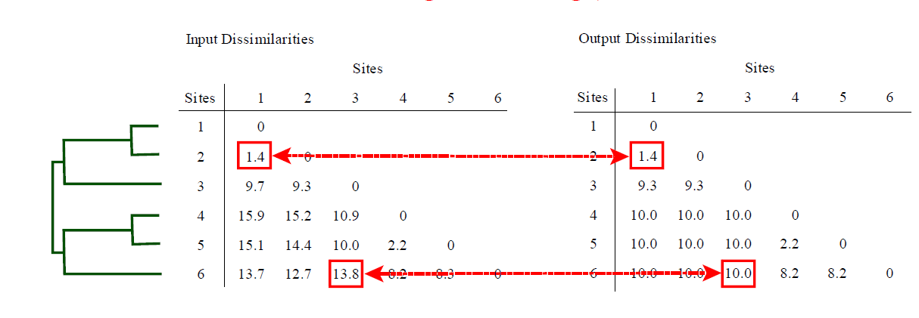
Evaluating the Cluster Solution Cophenetic Correlation Coefficient

Slide 34
Evaluating the Cluster Solution Agglomerative Coefficient (AC)
0.17
Measure of the clustering structure of the data.
For each sample (i), m(i) is its dissimilarity to the first
cluster it is merged with divided by the dissimilarity of
the final merger of the algorithm. The agglomerative
coefficient is the average of 1- m(i) for all samples (i).
AC = 0, no cluster structure; AC = 1, clear cluster
structure.
0.02

Slide 35
Evaluating the Cluster Solution Agglomerative Coefficient (AC)
0.17
Measure of the clustering structure of the data.
For each sample (i), m(i) is its dissimilarity to the first
cluster it is merged with divided by the dissimilarity of
the final merger of the algorithm. The agglomerative
coefficient is the average of 1- m(i) for all samples (i).
AC = 0, no cluster structure; AC = 1, clear cluster
structure.
0.02
m(Bahamas) = 0.02/0.17 = 0.12
1- m(Bahamas) = 0.88

Slide 36
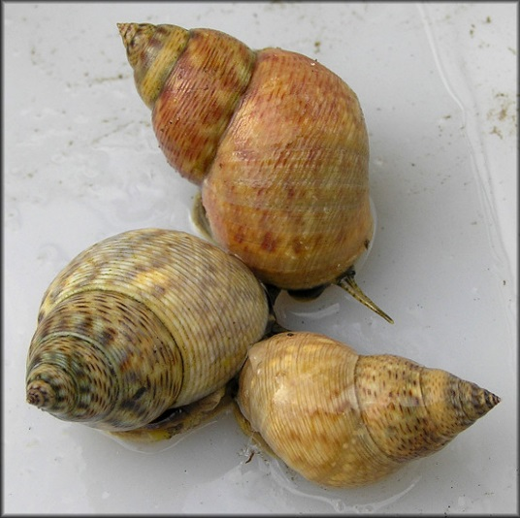
PAHC example Shell morphology of Littoraria angulifera
 | Proportionality | Circularity | SpireHeight
Angola | 1.36 | 0.76 | 1.69
Bahamas | 1.51 | 0.76 | 1.86
Belize | 1.42 | 0.76 | 1.85
Brazil | 1.43 | 0.74 | 1.71
Florida | 1.45 | 0.74 | 1.86
Haiti | 1.49 | 0.76 | 1.89
Liberia | 1.36 | 0.75 | 1.69
Nicaragua | 1.48 | 0.74 | 1.69
Sierra Leone | 1.35 | 0.73 | 1.72
Photos from jaxshells.org

Slide 37
Single-Linkage

Slide 38
Complete-Linkage

Slide 39
Centroid-Linkage

Slide 40
Median-Linkage

Slide 41
Average-Linkage (UPGMA)

Slide 42
Wards Minimum Variance

Slide 44
Evaluating the cluster solution?
Fusion Method | Cophenetic Correlation Coef. | Agglomerative Coefficient
Single | 0.93 | 0.76
Complete | 0.93 | 0.85
Centroid | 0.93 | 0.75
Median | 0.93 | 0.73
Average | 0.93 | 0.82
Ward | 0.92 | 0.94

Slide 45
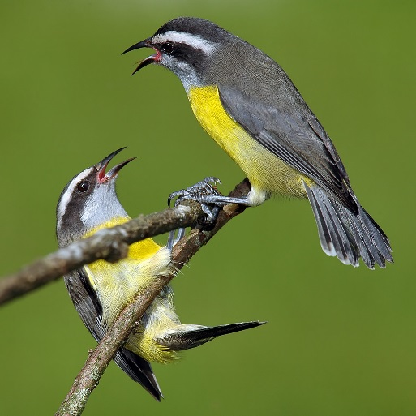
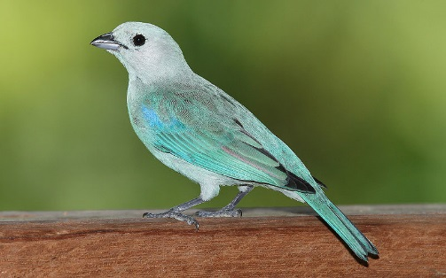
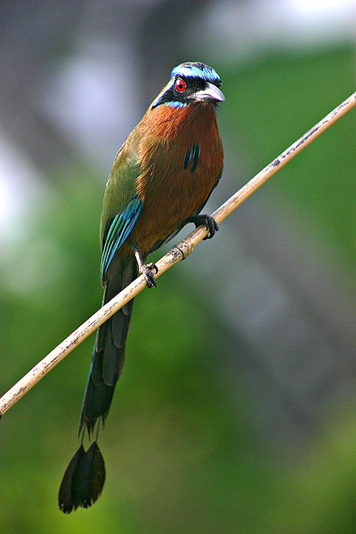
Better Example: Birds of the Caribbean
Photos by Stephen Turner

Slide 46
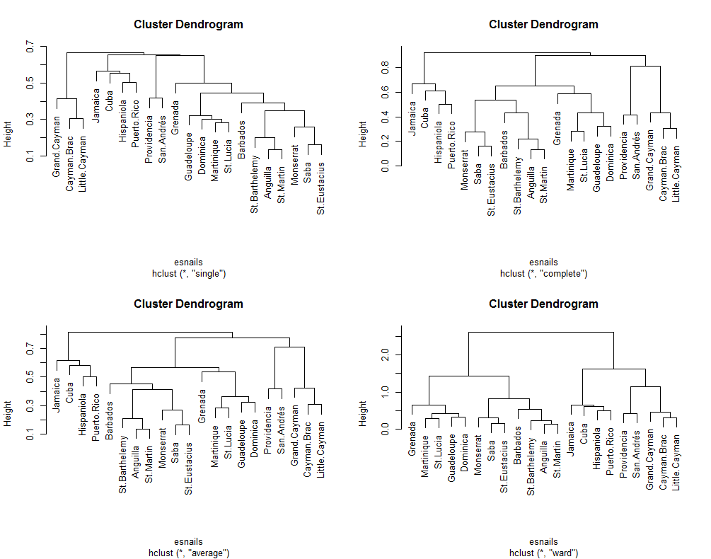

Slide 48
Evaluating the cluster solution
Fusion Method | Cophenetic Correlation Coef. | Agglomerative Coefficient
Single | 0.94 | 0.45
Centroid | 0.83 | NA
Median | 0.75 | NA
Complete | 0.95 | 0.61
Average | 0.95 | 0.57
Ward | 0.83 | 0.86

Slide 49
Evaluating the cluster solution
Fusion Method | Cophenetic Correlation Coef. | Agglomerative Coefficient
Single | 0.94 | 0.45
Centroid | 0.83 | NA
Median | 0.75 | NA
Complete | 0.95 | 0.61
Average | 0.95 | 0.57
Ward | 0.83 | 0.86

Slide 51
Polythetic Divisive Hierarchical Clustering
DIANA – DIvisive hierarchical ANAlysis algorithm
can be used on any dissimilarity matrix.
MONA – MONothetic hierarchical Analysis algorithm
designed for binary variables and focuses on one variable
per clustering step.

Slide 52
Polythetic Divisive Hierarchical Clustering
DIANA – DIvisive hierarchical ANAlysis algorithm
can be used on any dissimilarity matrix.
MONA – MONothetic hierarchical Analysis algorithm
designed for binary variables and focuses on one variable
per clustering step.

Slide 53
Polythetic Divisive Hierarchical Clustering DIANA
The diana algorithm constructs a
hierarchy of clusterings, starting with
one large cluster containing all n
samples an ends when each cluster contains only a single sample.
At each stage, the cluster with the
largest diameter is selected. (The
diameter of a cluster is the largest
dissimilarity between any two of its
samples.)

Slide 54
Polythetic Divisive Hierarchical Clustering DIANA
The diana algorithm first selects the most
dissimilar sample (i.e., largest
average dissimilarity to other samples).
This sample initiates the “splinter group”.

Slide 55
Division Process
2
4
1
5
3
6

Slide 56
Polythetic Divisive Hierarchical Clustering DIANA
The diana algorithm then reassigns samples that are closer to the “splinter group” than to the “old group”.

Slide 57
Division Process
2
4
1
5
3
6

Slide 58
Polythetic Divisive Hierarchical Clustering DIANA
Distance between clusters is the maximum
distance between two samples in the two clusters.

Slide 59
Division Process
2
4
1
15.9
5
3
6

Slide 60
Polythetic Divisive Hierarchical Clustering DIANA

Slide 61
Division Process
2
1
4
5
9.7
3
6

Slide 62
Polythetic Divisive Hierarchical Clustering DIANA

Slide 63
Division Process
2
1
5
4
8.3
3
6

Slide 64
Polythetic Divisive Hierarchical Clustering DIANA

Slide 65
Polythetic Divisive Hierarchical Clustering DIANA
Divisions are based on average distances (similar to ‘average-linkage’), but cophenetic distance is based on maximum distances between samples in the two subclusters (similar to ‘complete linkage’).

Slide 66
Caribbean Birds - DIANA

Slide 67
Evaluating the cluster solution
Division Method | Cophenetic Correlation Coef. | Divisive Coefficient
DIANA | 0.95 | 0.61
*Bootstrapping available

Slide 68
PAHC vs. PDHC
Fusion Method | Cophenetic Correlation Coef. | Divisive Coefficient
Average | 0.95 | 0.57
Division Method | Cophenetic Correlation Coef. | Divisive Coefficient
DIANA | 0.95 | 0.61

Slide 69
PAHC vs. PDHC
Fusion Method | Cophenetic Correlation Coef. | Divisive Coefficient
Average | 0.95 | 0.57
Division Method | Cophenetic Correlation Coef. | Divisive Coefficient
DIANA | 0.95 | O.61

Slide 70
PAHC vs. PDHC
PAHC techniques begin
by examining small
distances between similar
samples, yet these small
distances are likely to be a
reflection of noise than
anything else.
PDHC techniques begin by
examining overall, major
gradients in the data; all the
available information is
used to make the critical
topmost divisions.

Slide 71
PAHC vs. PDHC
* MORE POPULAR
PAHC techniques begin
by examining small
distances between similar
samples, yet these small
distances are likely to be a
reflection of noise than
anything else.
PDHC techniques begin by
examining overall, major
gradients in the data; all the
available information is
used to make the critical
topmost divisions.

Slide 72
Limitations to Cluster Analysis
Most clustering procedures are biased towards finding clusters in general
and clusters of certain shapes. Compare different methods and procedures,
disagreement probably means not well defined clusters.
Are clusters real and do they reflect the original data structure? Methods exist
testing, but ultimately up to qualitative judgment, subjective evaluation,
and interpretability.
Because cluster analyses involve so many choices, compare methods and
procedures. “more of an art than a science”

Slide 73
Big Picture Utility
Non-hierarchical should be used with > 50 samples.
Non-hierarchical groups can then be an input to hierarchical cluster analysis.
Use hierarchical clustering when relationships between and among groups are desired.
Groups identified with cluster analysis and can be projected in to ordination
space (PCA, PCoA, NMDS).
Finally, next week we will learn techniques for testing if groups are significantly
different from each other!

